Slide 1
Introducing
Application Manager
January 25, 2021

Slide 2
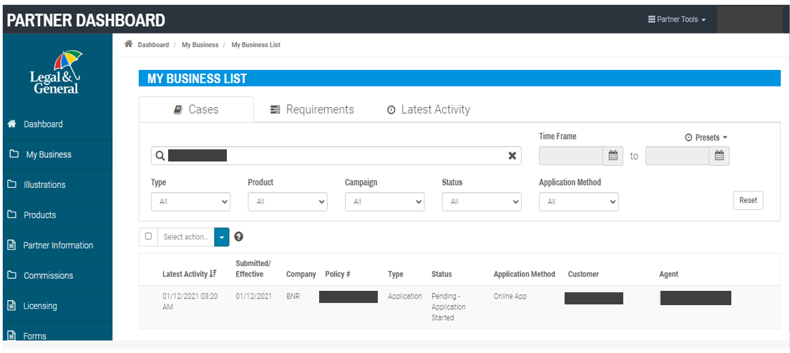
Navigating into Application Manager from “My Business List”
Key Features :
Click on “Application” from the My Business List screen on Partner Dashboard. As long as application has been signed, you will be taken to the Application Manager.

Slide 3
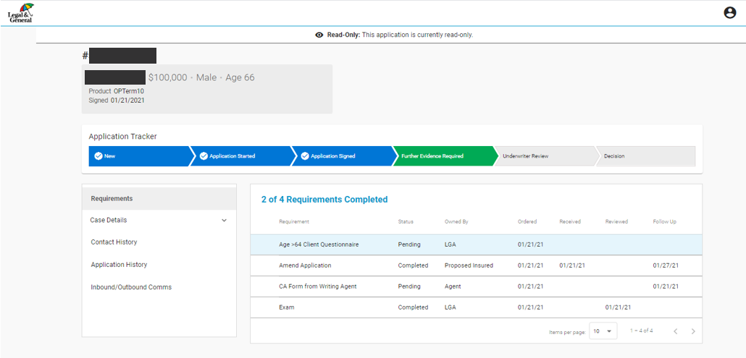
Application Manager: Requirements
Key Features :
The tracker will show current status, with blue chevrons showing completed streams. The current open stream (green) will show status and timelines.
The Requirements section provides the needed requirement, status, the order date, received date, if the requirement has been reviewed, and the next follow up date.

Slide 4
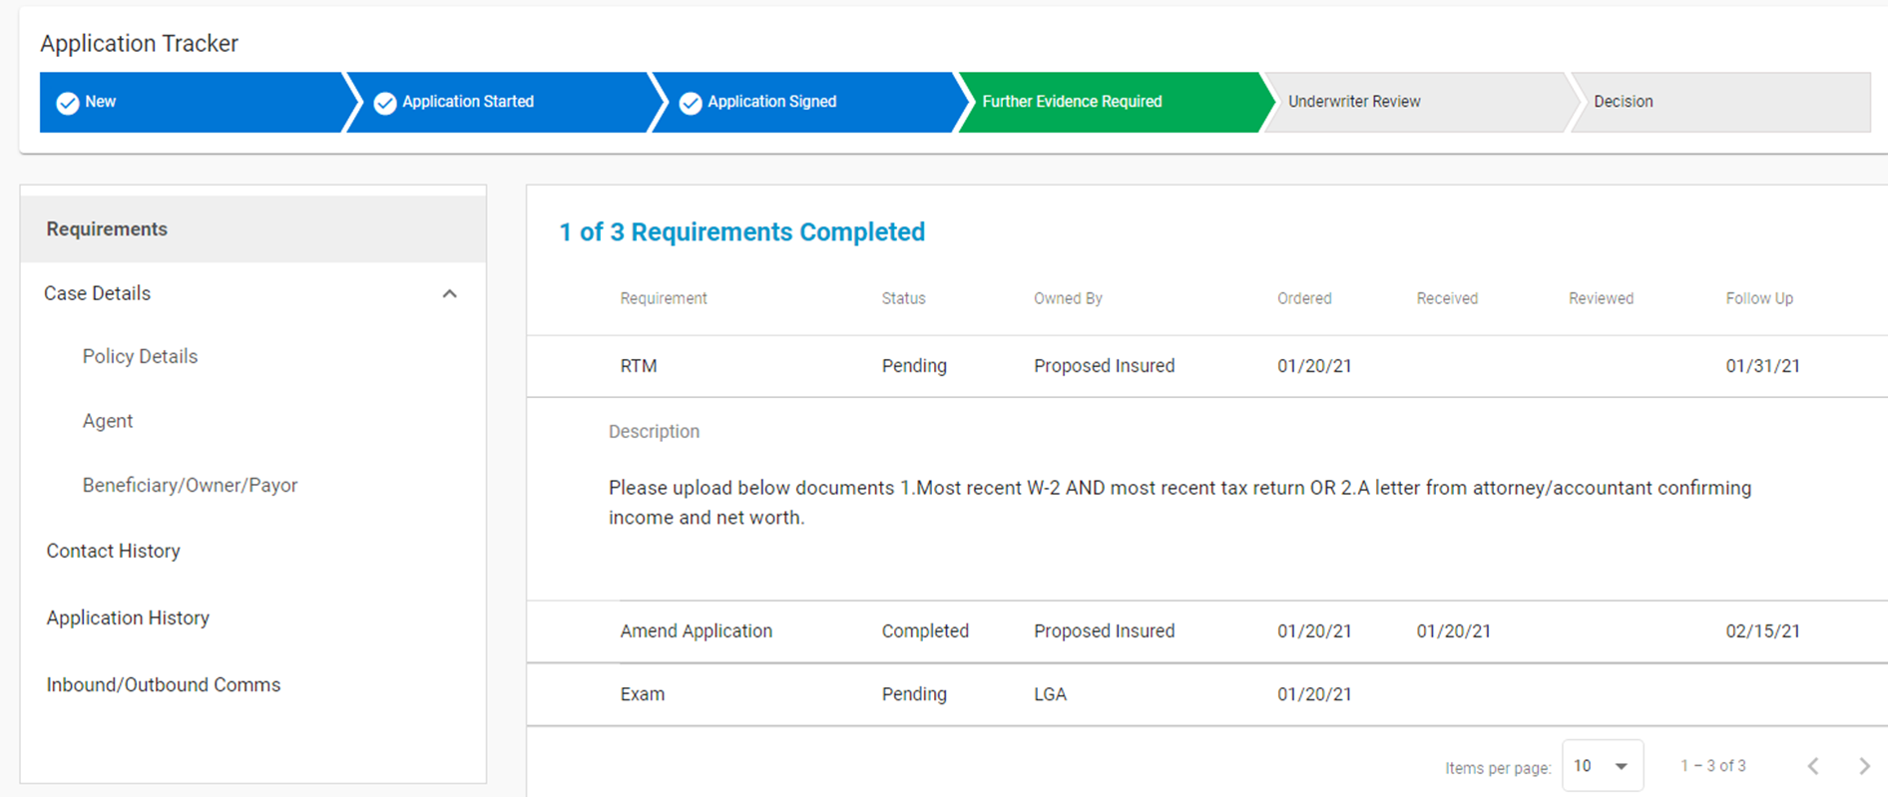
Application Manager: Requirements
For each requirement, you can click on it and drill down into more detailed
Exam document/report is available in the document section once it is complete and received.

Slide 5
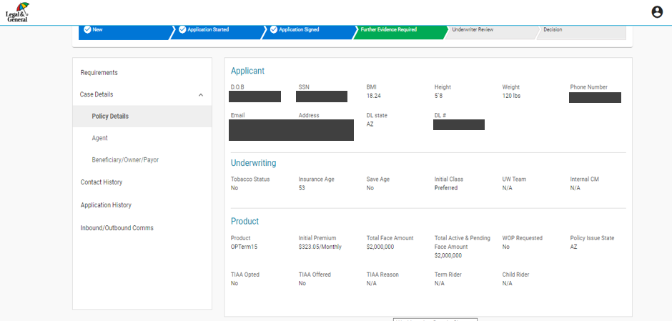
Application Manager: Case Details
Within Case Details, there are 3 sections of key information
The first section is Policy Details, which includes applicant information, initial underwriting class and proposed product details.

Slide 6
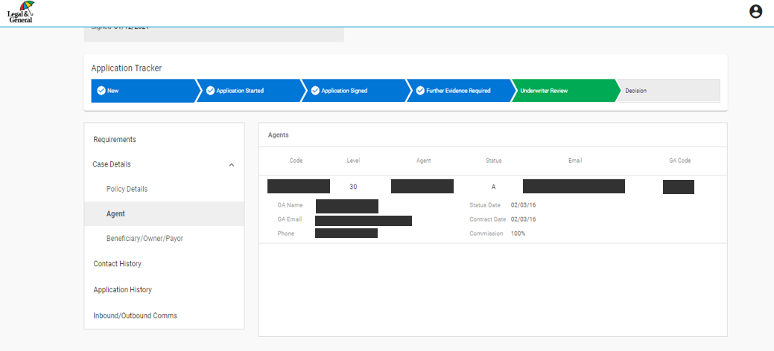
Application Manager: Case Details
The second section of key information is the agent information and details.

Slide 7
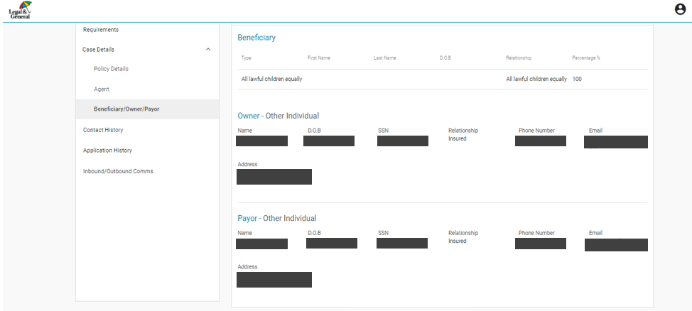
Application Manager: Case Details
The last piece of key information includes the beneficiary, owner and payor details.

Slide 8
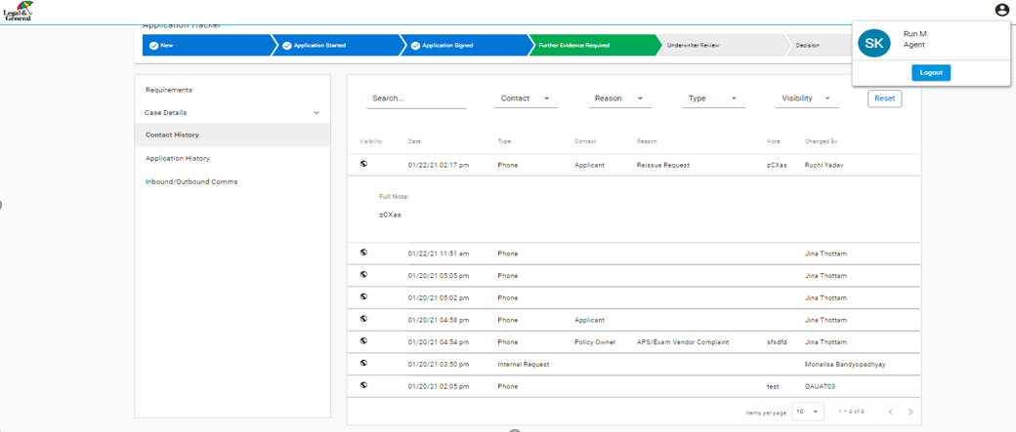
Application Manager: Contact History
Contact History will let you see interactions with a customer and others involved in the application process.

Slide 9
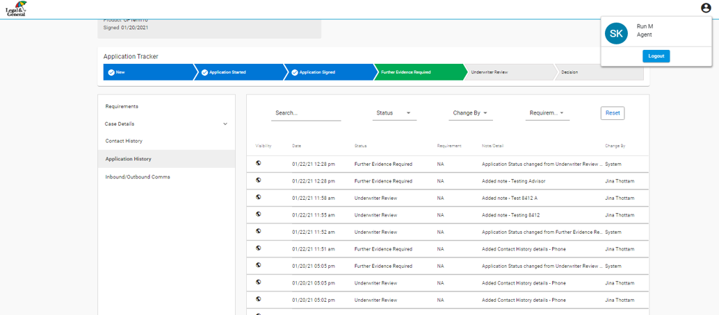
Application Manager: Application History
Application History displays the history of the case and includes the underwriting notes. An entry can be clicked on for more details.

Slide 10
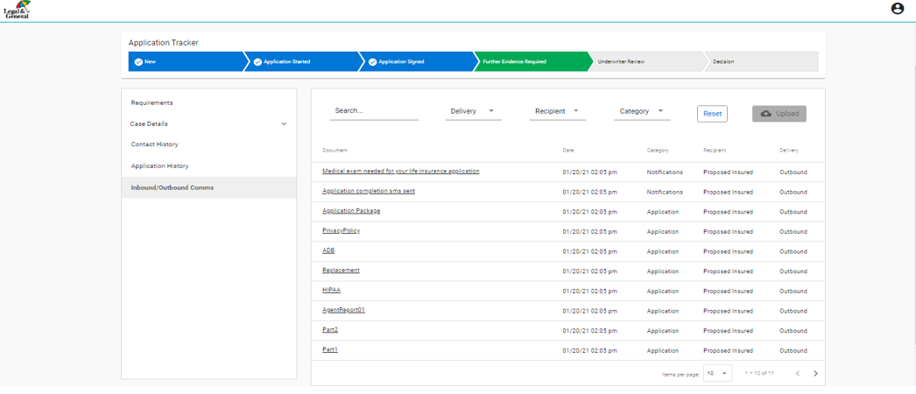
Application Manager: Inbound/Outbound Communications
Inbound/Outbound Comms is the section where policy documents can be viewed and uploaded (including the application, APS and exam), as well as all communications sent and received.

Slide 11
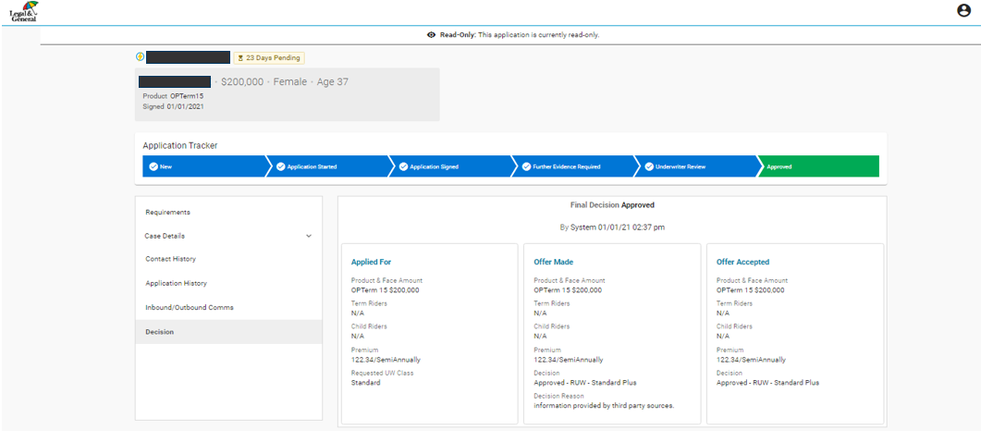
Application Manager: Underwriter Review
When underwriting review is complete, decision tab will be updated.
Once all evidence is captured and processed, the application will be in the “Underwriter Review” phase.
Requirements for the underwriting process will be included here, along with key dates so you understand where a case is in the underwriting process.

